Slide 1



predict hit songs on Spotify.
Introduction

Slide 2

Play
Follow
Upgrade
John Doe
k
Introduction
What Makes a Hit?
Data Collection
Data Preparation
Overview of the project's aim to predict hit songs on Spotify.
Audio Features' Role: aspects like beat, rhythm, and harmony contribute to a song's appeal and streaming numbers.
Listener Preferences: listener preferences in audio features vary across genres and demographics.
Data-Driven Insights: most predictive features for hit potential: danceability, tempo, and energy.
Model Predictions:
Statistical Differences: Statistical differences in audio features between hit and non-hit songs.
Trend Analysis: Offer insights into how hits may align with or diverge from current music trends.
EDA
Feature Selection
Modeling Approach
Evaluation Metrics
Results and Insights
Challenges
Conclusion

Slide 3


Upgrade
John Doe
Introduction
Data Collection
Description of data collection from Spotify’s API and datasets used.
Data Preparation
Data Collection
EDA
Feature Selection
Modeling Approach
Spotify API
GitHub
Evaluation Metrics
register your application on the Spotify Dev. Dashboard to obtain Client ID and Client Secret. Then make authenticated requests to the API endpoints, retrieving user data, playlists, or track information, according to Spotify's Web API documentation and access scopes.
I created a repository on GitHub to store my code and data files. I then used Python, to write scripts that fetched data from the Spotify API and saved it in a CSV. These scripts and data files were then sent to R for statistical modeling.
Results and Insights
Challenges
Conclusion
Cleaning Datasets
Merging Datasets

Slide 4
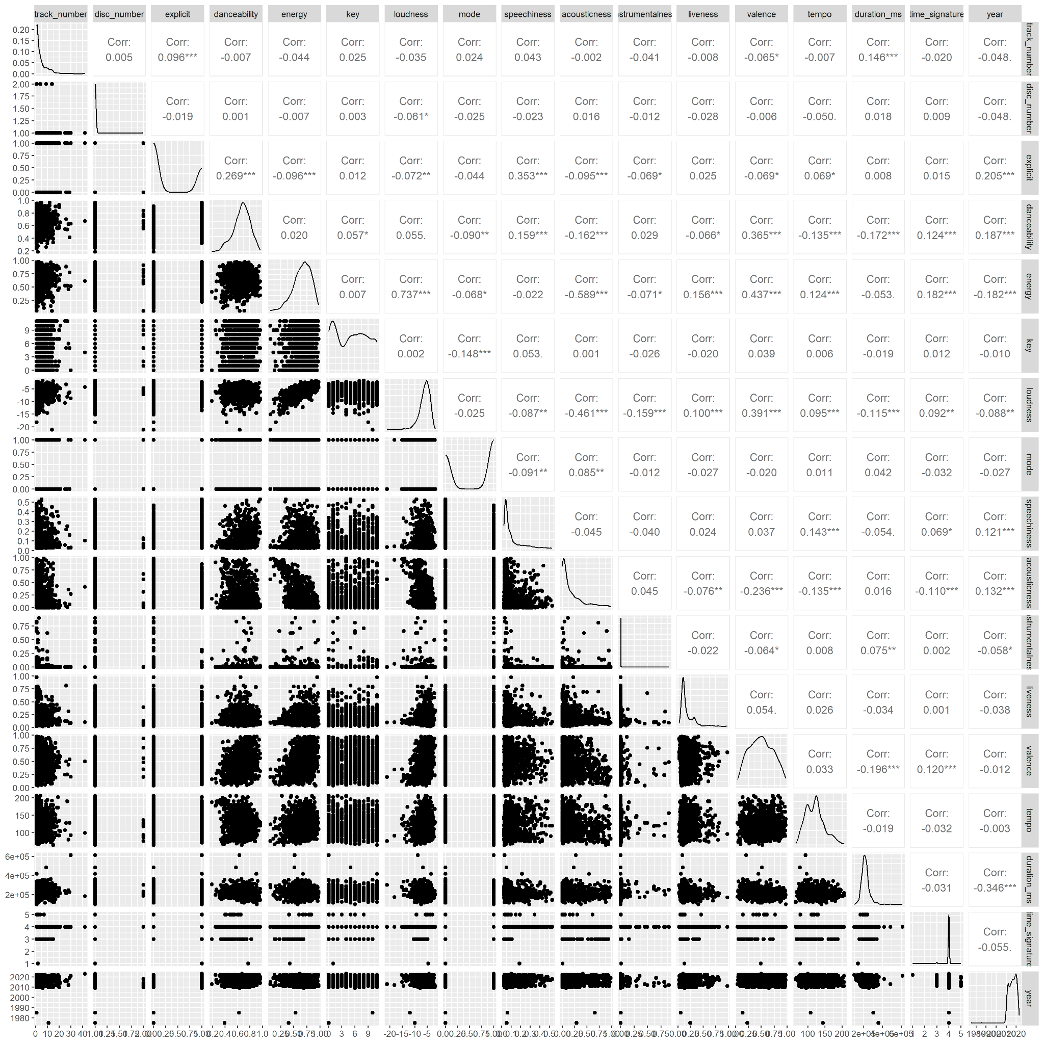
Exploratory Data Analysis
EDA
Upgrade
Introduction
Data Collection
Data Preparation
EDA
Feature Selection
Modeling Approach
Evaluation Metrics
Results and Insights
Challenges
Conclusion

Slide 5
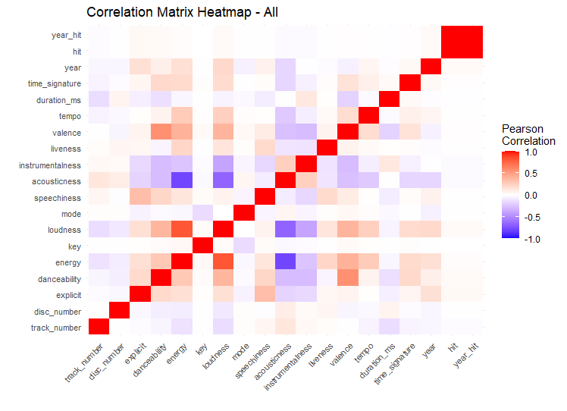
Exploratory Data Analysis
EDA
Upgrade
John Doe
Introduction
Data Collection
Data Preparation
EDA
Feature Selection
Modeling Approach
Evaluation Metrics
Results and Insights
Challenges
Conclusion

Slide 6
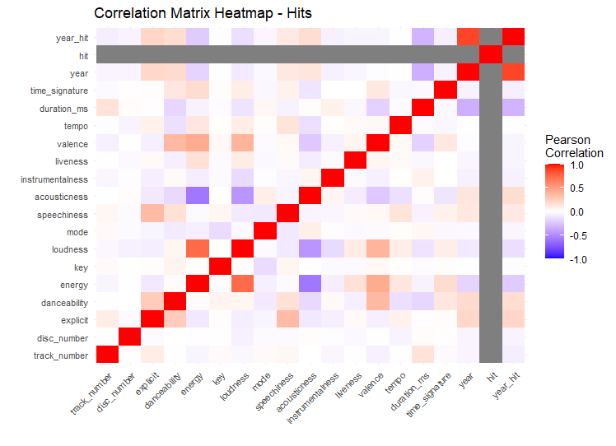
Exploratory Data Analysis
EDA
Upgrade
John Doe
Introduction
Data Collection
Data Preparation
EDA
Feature Selection
Modeling Approach
Evaluation Metrics
Results and Insights
Challenges
Conclusion

Slide 7
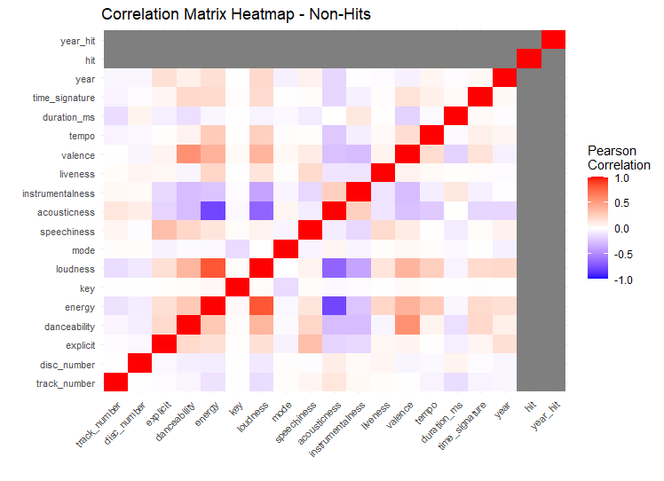
Exploratory Data Analysis
EDA
Upgrade
John Doe
Introduction
Data Collection
Data Preparation
EDA
Feature Selection
Modeling Approach
Evaluation Metrics
Results and Insights
Challenges
Conclusion

Slide 8
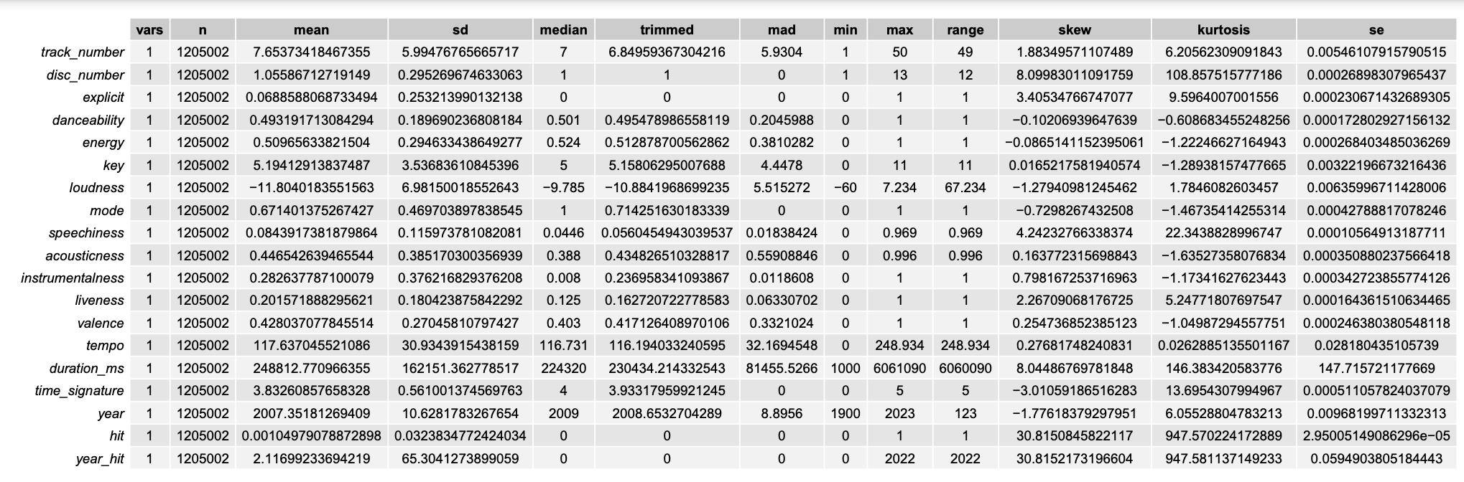
Upgrade
John Doe
Results- All Hits

Slide 9
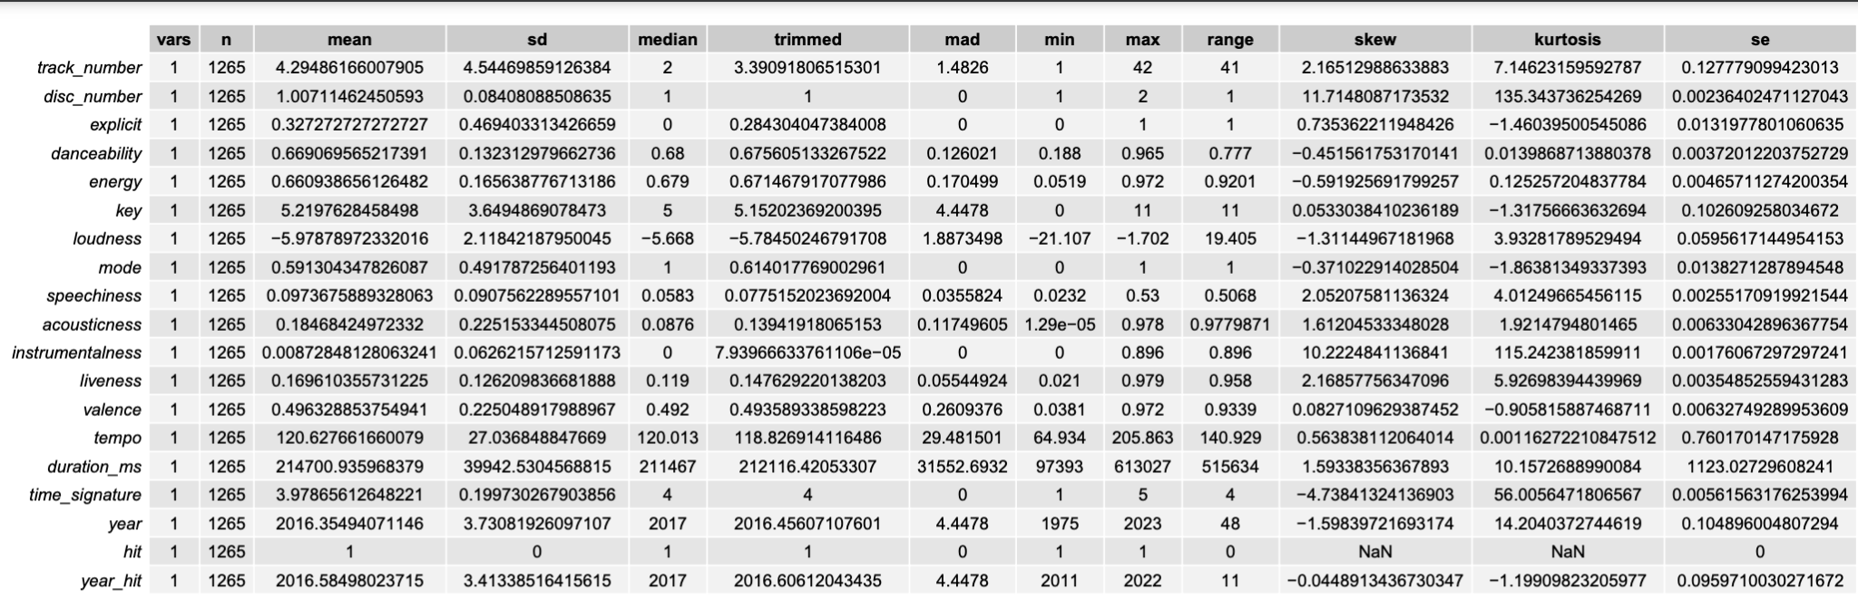
Upgrade
John Doe
Results - Hits

Slide 10
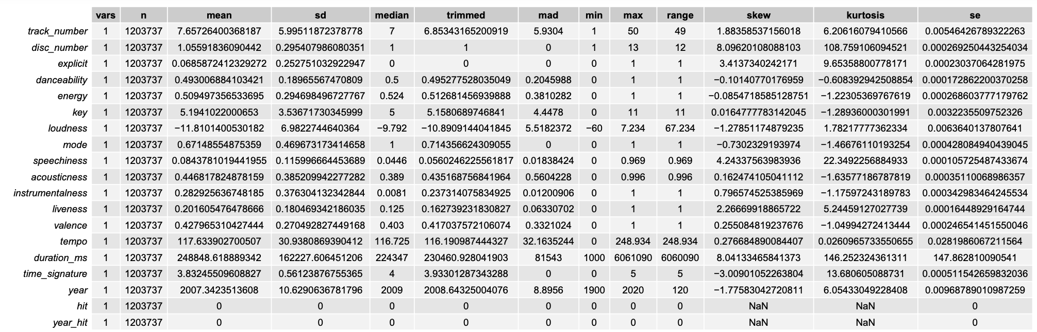
Upgrade
John Doe
Results - Non Hits

Slide 11
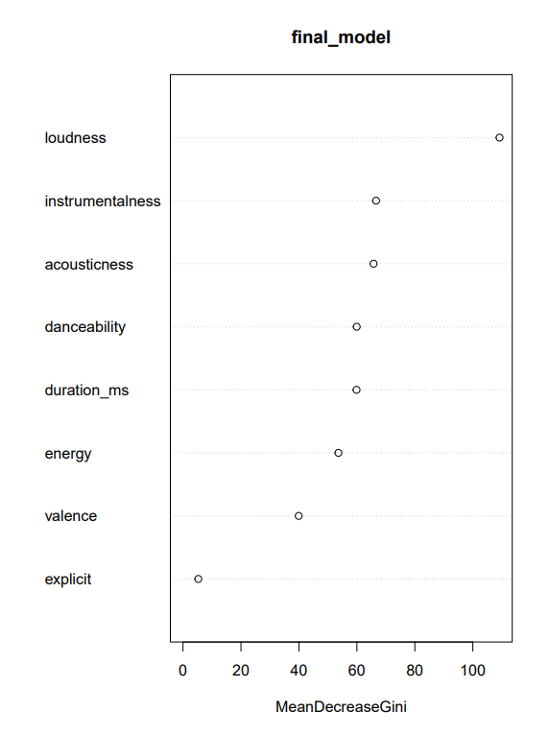
Upgrade
John Doe
Feature Selection
Introduction
Data Collection
Explanation of the feature correlation and selection process.
Data Preparation
Subset Data
01
EDA
Feature Selection
rfeControl()
Backwards
02
Modeling Approach
Evaluation Metrics
Results and Insights
Challenges
Conclusion

Slide 12
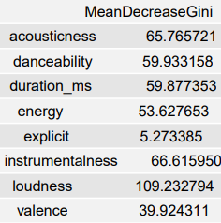
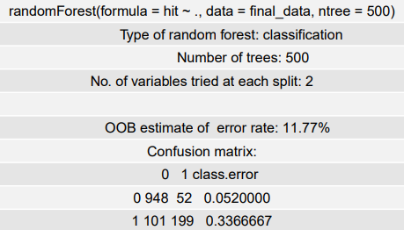
Upgrade
John Doe
Introduction
Data Collection
Data Preparation
EDA
Feature Selection
Modeling Approach
Evaluation Metrics
Results and Insights
Challenges
Conclusion

Slide 13
Upgrade
John Doe
Introduction
Modeling Approach
Data Collection
Had to shrink dataset (will adjust again)
-3 years (2011, 2012, 2013)
-non_hits to random 1000 (setseed)
Binary classification models used and the model fitting process.
-RF
-Logistic Regression (TBD)
Data Preparation
EDA
Feature Selection
Modeling Approach
Evaluation Metrics
Results and Insights
Challenges
Conclusion

Slide 14




Upgrade
John Doe
Introduction
Data Collection
Evaluation Metrics
Data Preparation
EDA
Model Evaluation.
Feature Selection
F1 Score
Precision
Modeling Approach
Evaluation Metrics
Results and Insights
Loss
AUC
Challenges
Conclusion

Slide 15
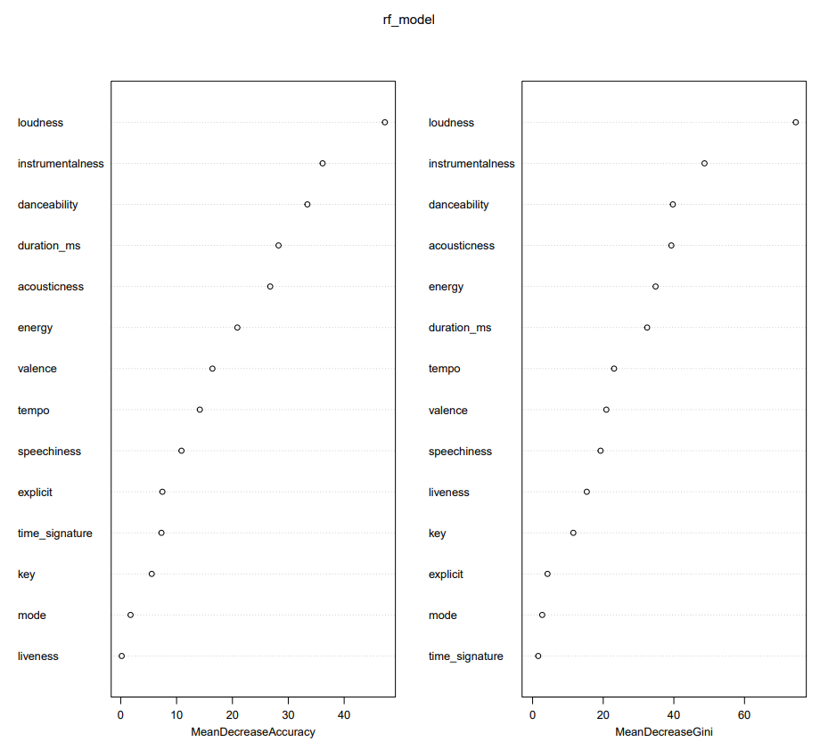
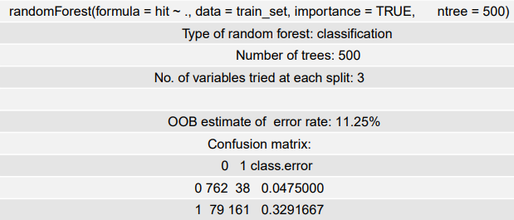
Upgrade
John Doe
Introduction
Results and Insights
Data Collection
Data Preparation
Good at predicting non_hits but not at predicting hits
F1: 0.9156627
EDA
Feature Selection
Modeling Approach
Evaluation Metrics
Results and Insights
Challenges
Conclusion

Slide 16
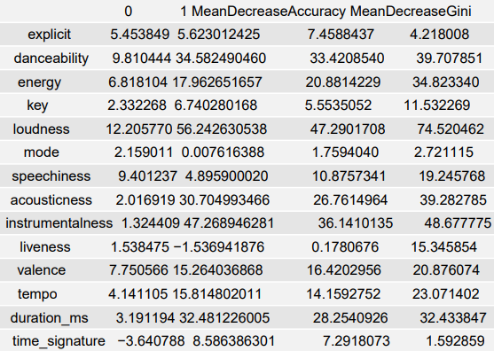
Upgrade
John Doe
Introduction
Data Collection
Data Preparation
EDA
Feature Selection
Modeling Approach
Evaluation Metrics
Results and Insights
Challenges
Conclusion

Slide 17
Upgrade
John Doe
Introduction
Data Collection
Best prices
Data Preparation
Challenges & Learning
EDA
Feature Selection
Dataset too large
-from 12 yrs to 3-ish
-non_hits to 1:3 ratio
Artists have large effect on if a song becomes a hit (domain knowledge) but too computationally intensive for this
Plan to adjust subsets of data and rerun with larger samples in non_hits
Modeling Approach
Evaluation Metrics
Results and Insights
Challenges
Conclusion

Slide 18


Thank You
Despacito
Luis Fonsi, Daddy Yankee
0:23
-3:25

